Slide 1
Expressionism in Germany

Slide 2
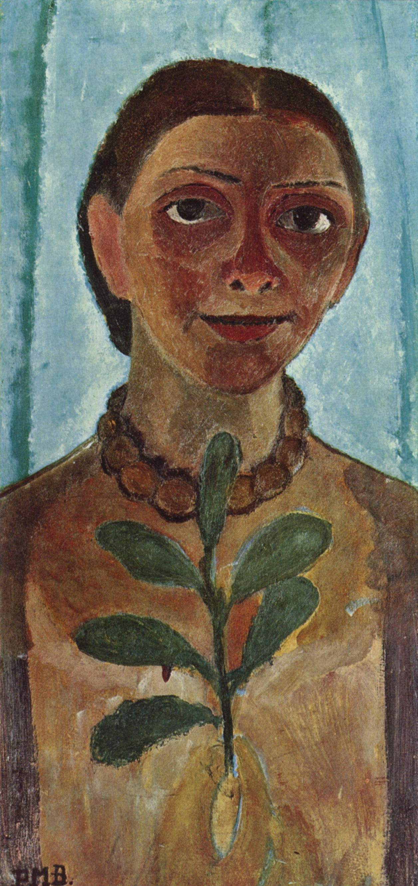
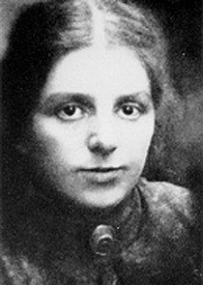
Paula Modersohn-Becker (German, 1876-1907: 31 years) from Post-Impressionism to Proto-Expressionism
Self Portrait, 1907

Slide 3
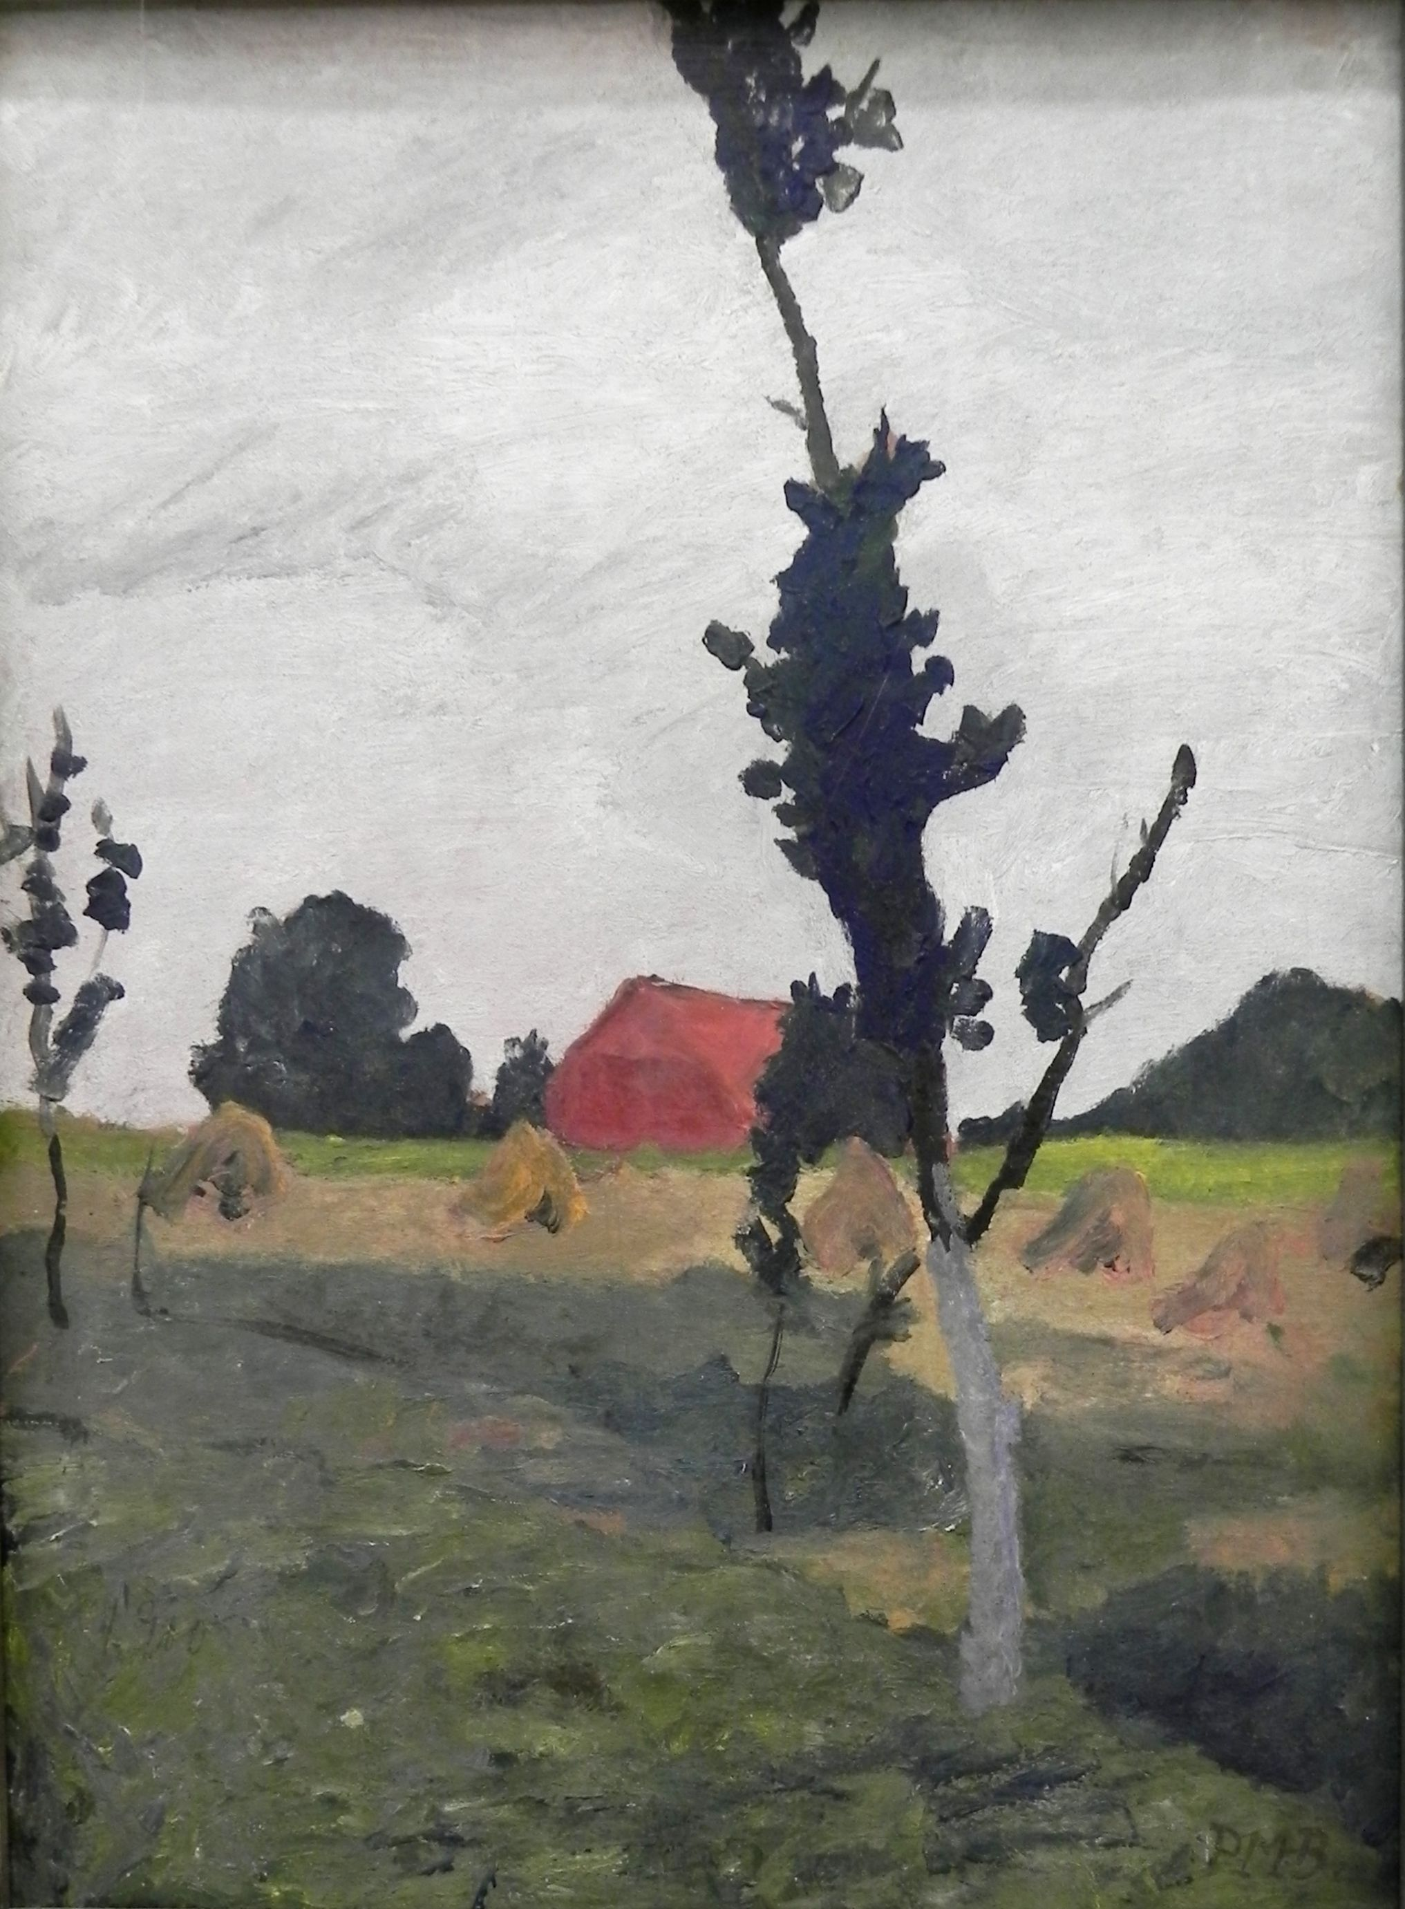
(left) Otto Modersohn, Moor Grasses, 1895 (right) Paula Modersohn-Becker, Red House, 1900 Worpswede, a rural German village and artist colony

Slide 4
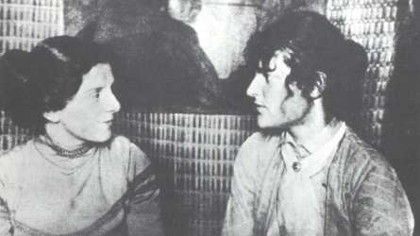
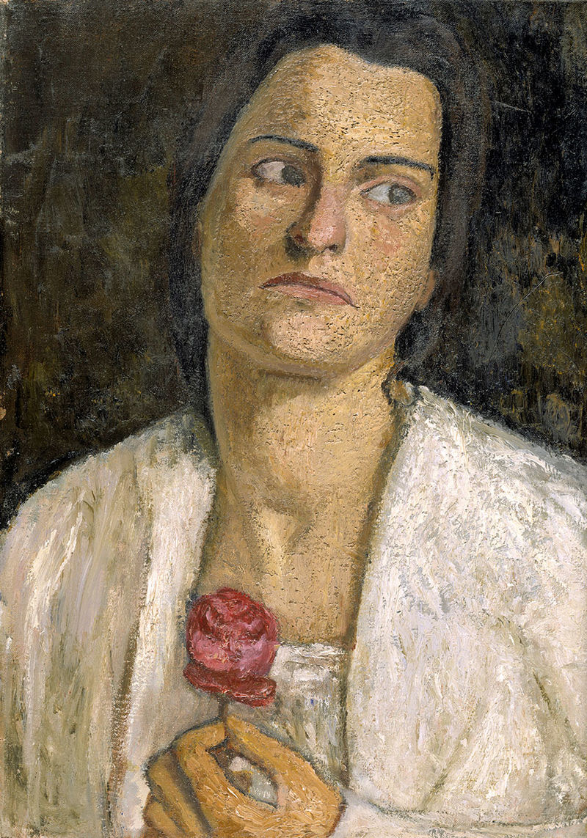
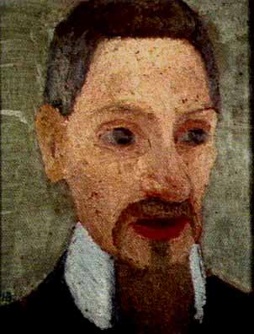
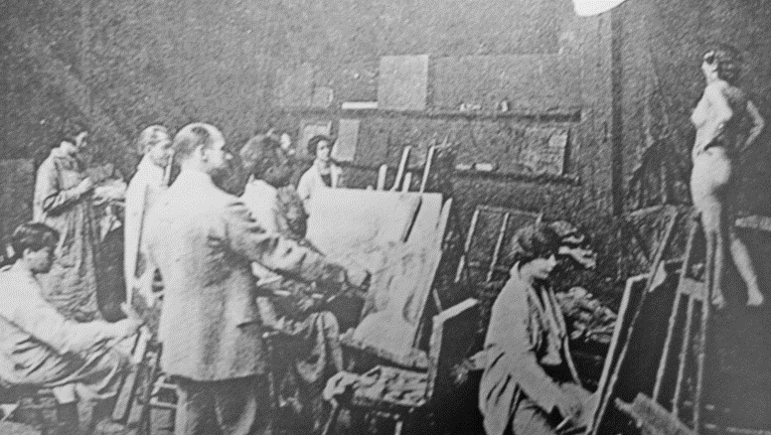
Paula Modersohn-Becker (left) with sculptor Clara Westhoff Becker spent 6 months in Paris 1900 where Westhoff was studying with Auguste Rodin and attending the Académie Colarossi, an alternative artist-founded school that admitted women (below)
Modersohn-Becker, Clara Westhoff, 1905, sculptor
(right) Rainer Maria Rilke, 1906, famous modern poet, husband of Westhoff, secretary to Auguste Rodin, and feminist
Life painting, Académie Colarossi

Slide 5
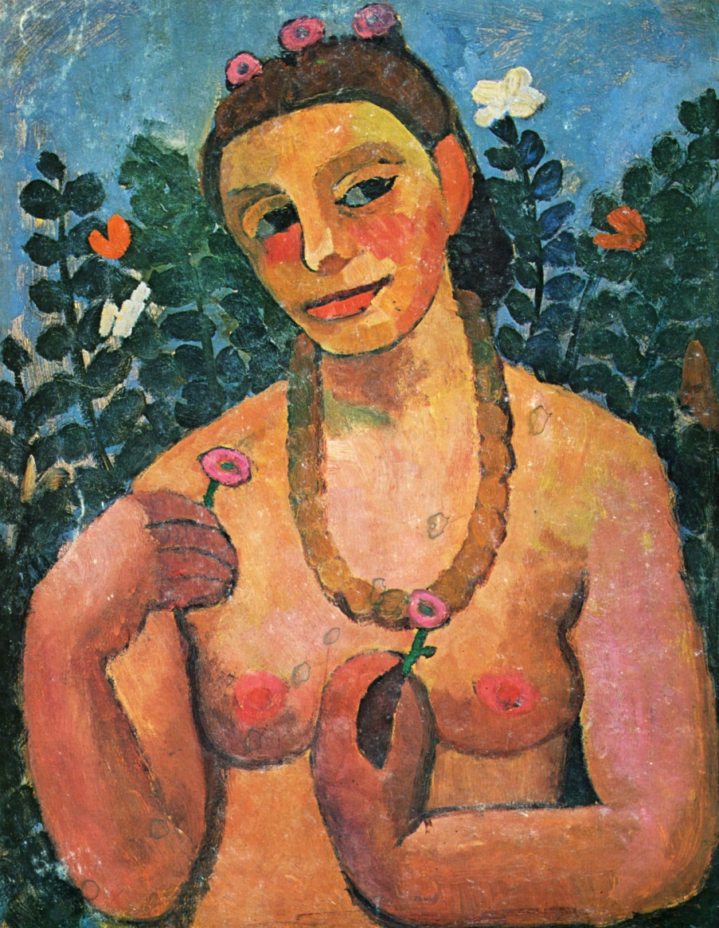
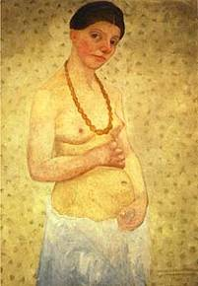
Paula Modersohn-Becker (right), Self Portrait on Her Sixth Wedding Day, 1906, oil on board, 101 cm high. (left) Self-Portrait with Amber Necklace, 1906. During the artist’s last (1906) stay in Paris she painted a series of nude self portraits, unprecedented by a woman artist and considered among the most historically significant works of her short career.

Slide 6
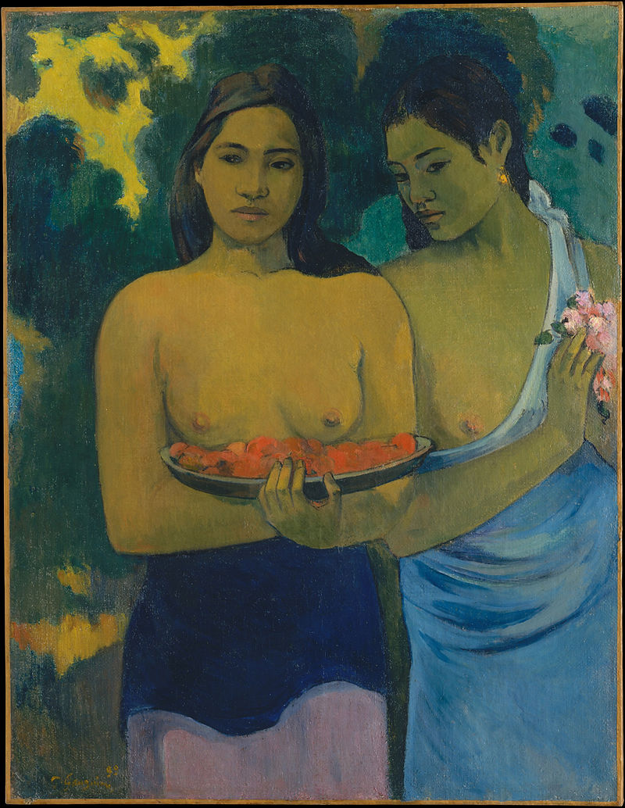
Paula Modersohn-Becker, Self-Portrait with Amber Necklace (left), 1906 Paul Gauguin, Two Tahitian Women (right), 1899

Slide 7
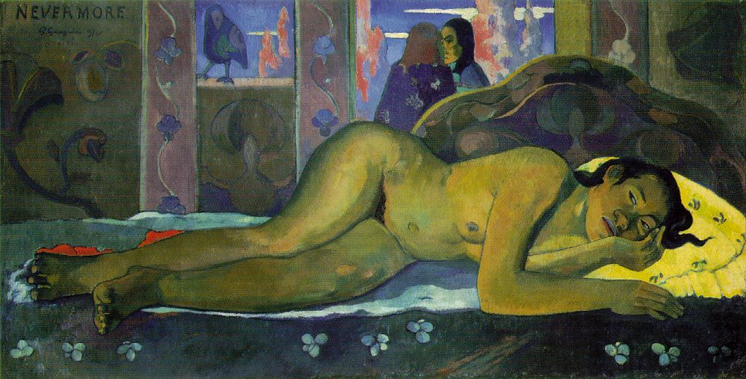
Modersohn-Becker, Reclining Mother and Child, 1906 (lower right) Paul Gauguin, Nevermore, 1897

Slide 8
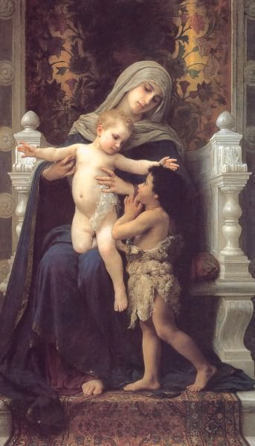
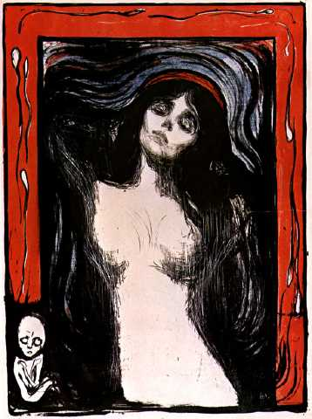
Paula Modersohn-Becker Reclining Mother and Child, 1906 A new genre: the maternal nude
Edvard Munch, Madonna, lithograph, 1895
William Bouguereau, Madonna and Child with Saint John the Baptist c. 1890.

Slide 9
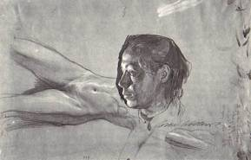
Käthe Kollwitz (German 1867-1945), Self Portrait and Nude Studies, 1900, graphite, pen and black ink. 280 x 445 cm. Stuttgart

Slide 10
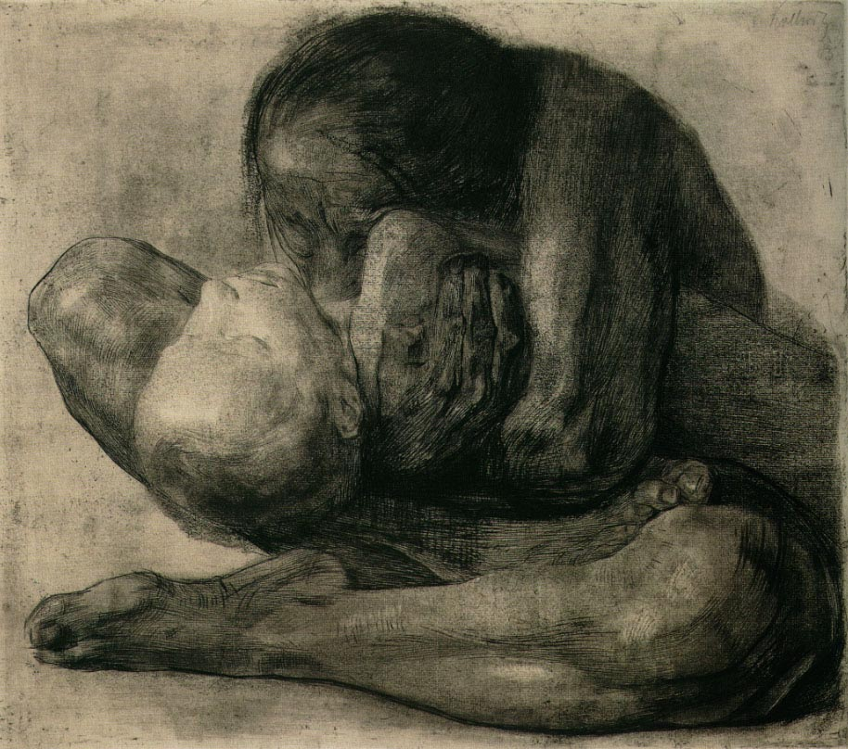
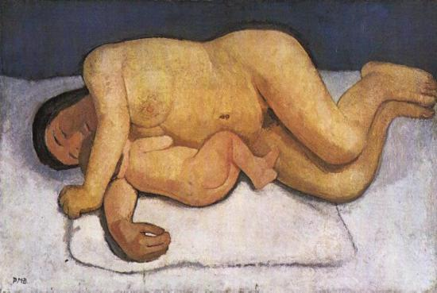
Käthe Kollwitz (German 1867-1945), Woman with Dead child, 1903, etching with engraving overprinted with a gold tone plate, 47.6 x 41.9 cm Paula Modersohn-Becker (German 1876-1907), Reclining Mother and Child, oil on canvas, 124.7 x 82 cm. 1906 (right)
The maternal nude is a new subject in the history of Western art
introduced by women artists to tell of a woman’s experience of body and life.

Slide 11
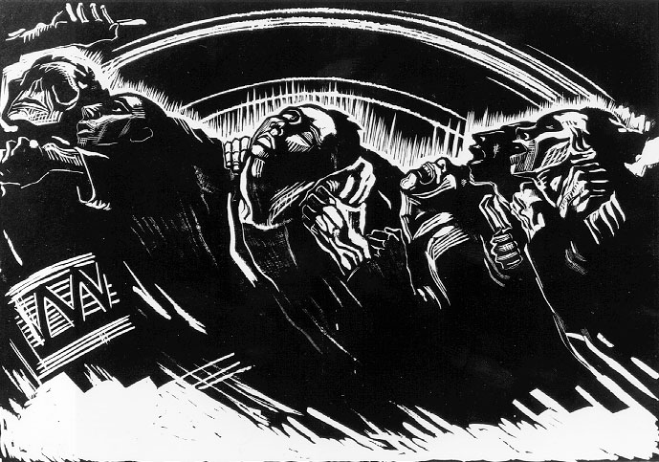
Käthe Kollwitz, The Volunteers, 1924, woodcut. Part of the War Cycle

Slide 12
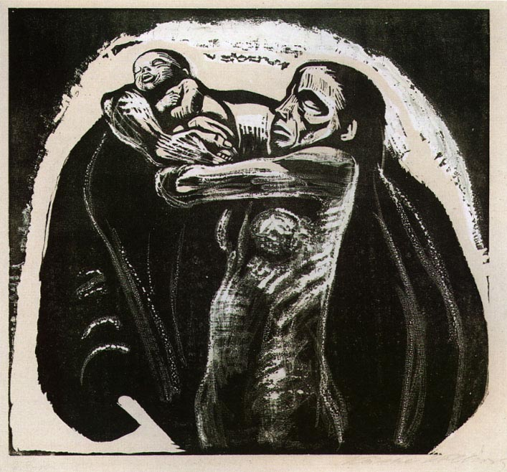
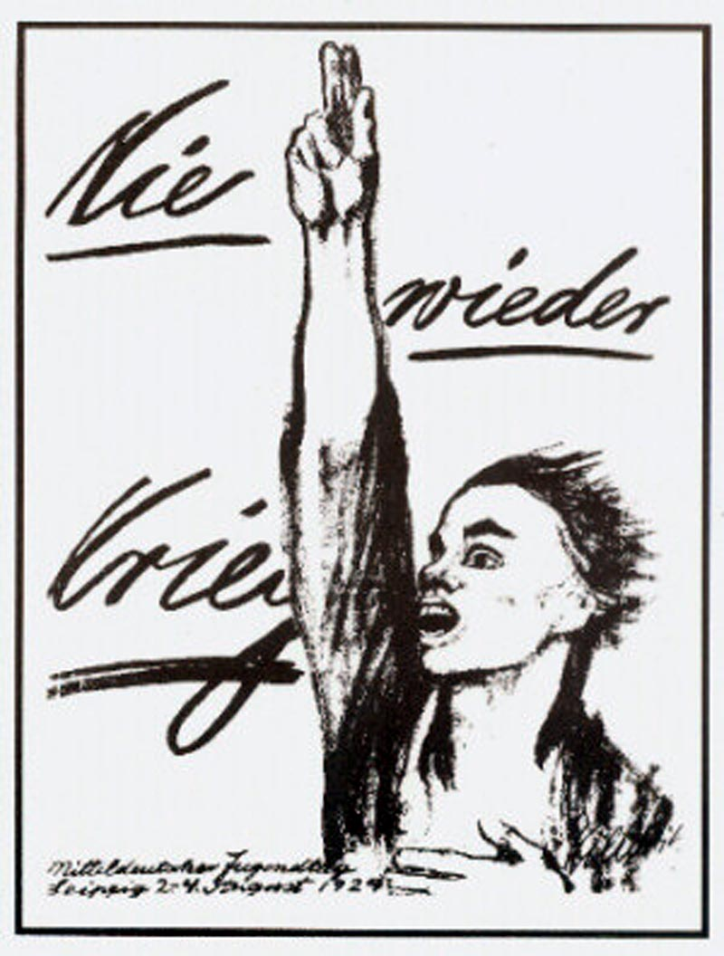
Käthe Kollwitz, The Sacrifice, woodcut, 1924, part of War Cycle (right) Nie Wieder Kreig! (No More War!), litho poster for the Social Democratic Party, 1924

Slide 13
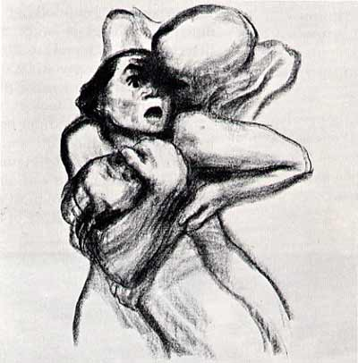
Käthe Kollwitz, Death Seizing a Woman,1934, from the series Death, 1934-36, lithograph printed in black, 20 x 15” MoMA NYC (right) Self Portrait, 1934, lithograph. In 1933 the Nazis made it illegal to display Kollwitz’s art and confiscated it, declaring "In the Third Reich mothers have no need to defend their children. The State does that.“ Kollwitz, the first woman elected to the Prussian Academy of Art in Berlin, was expelled.

Slide 14
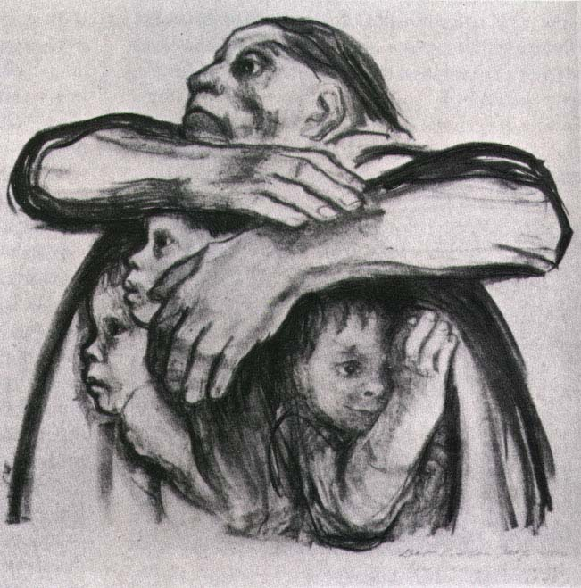
Käthe Kollwitz, The Seed for Planting Shall Not Be Ground, 1942, lithograph

Slide 15
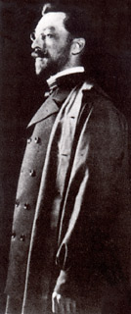
Wassily Kandinsky (Russian 1866-1944) The artist is not born to a life of pleasure. He must not live idle; he has a hard work to perform, and one which often proves a cross to be borne. He must realize that his every deed, feeling, and thought are raw but sure material from which his work is to arise, that he is free in art but not in life....The artist is not only a king...because he has great power, but also because he has great duties. Wassily Kandinsky, "Conclusion" Concerning the Spiritual in Art, 1912
Kandinsky developed his theory and practice of abstract expressionist art between 1908 - 1911: three years.

Slide 16
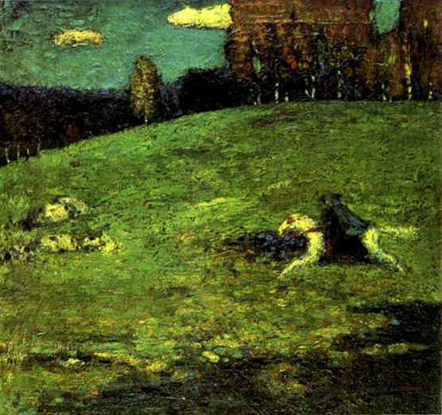
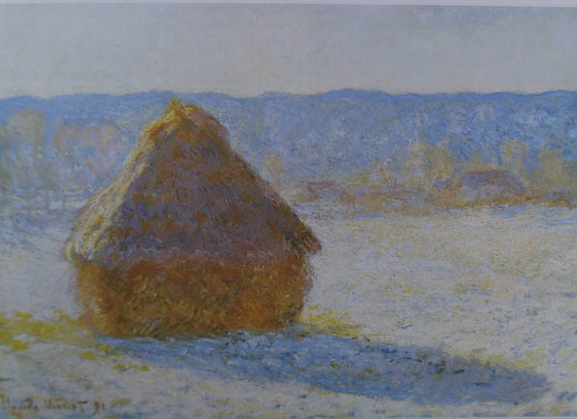
Wassily Kandinsky, The Blue Rider, oil on cardboard, 1903 Claude Monet, Haystack (Winter), 1891 Kandinsky's themes and symbolic objects become his iconography. The Blue Rider will recur and evolve according to the principles he defines in his theoretical essays, Concerning the Spiritual in Art and in The Blue Rider Almanac.

Slide 17
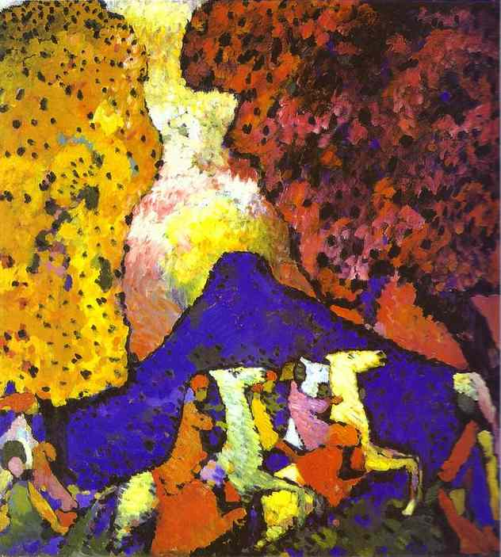
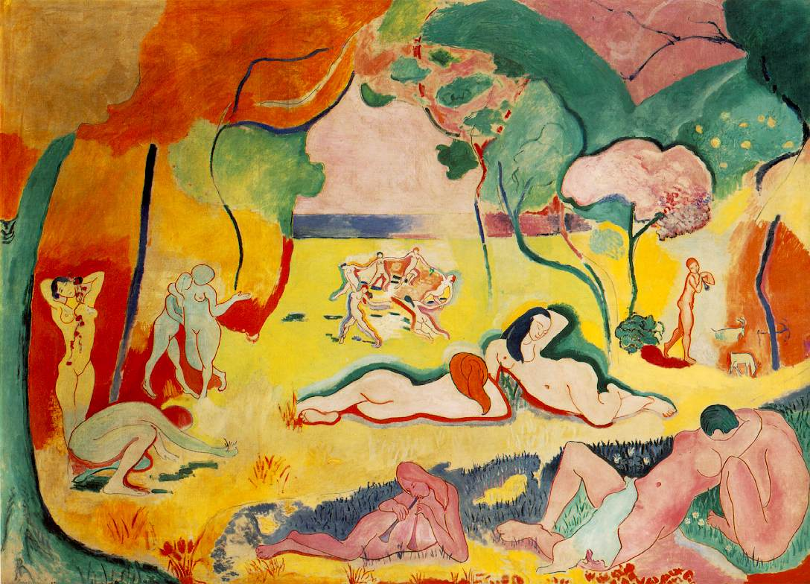
(left) Wassily Kandinsky, The Blue Mountain, 1908, o/c (below) Matisse, The Joy of Life, 1906 Kandinsky’s Fauvist (style) symbolist landscapes

Slide 18
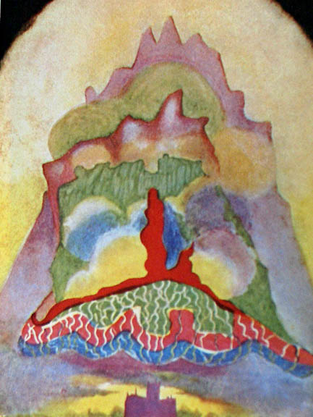
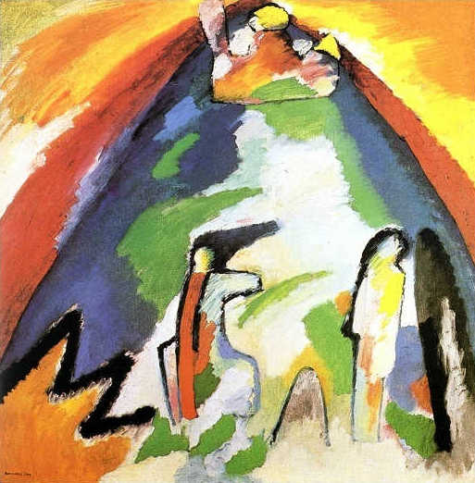
(right) Annie Besant and Charles Leadbeater (Theosophist), Thought-Form: Music of Wagner 1905, (left) Kandinsky, Mountain, 1908 Towards abstract painting

Slide 19
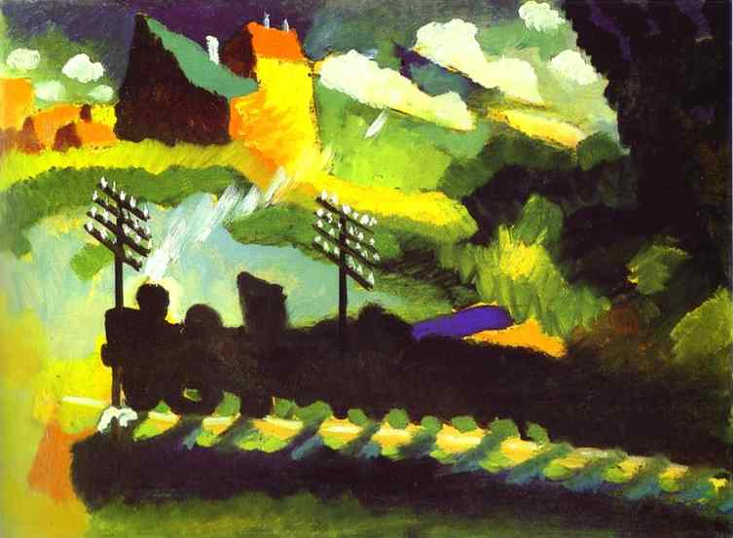
(left) Wassily Kandinsky, Murnau: View with Railroad and Castle, 1909, oil on cardboard Kandinsky, Church in Murnau, 1910, Oil on cardboard
Towards abstraction: track Kandinsky’s visual thinking

Slide 20
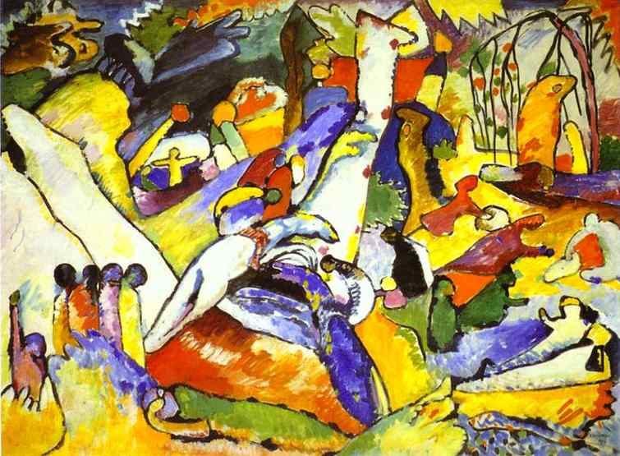
Wassily Kandinsky, Study for Composition 2, 1909-10, oil on canvas, 38 x 51”, Solomon Guggenheim Museum, NYC. Based on the Deluge (Genesis) and (Apocalypse) Revelations

Slide 21
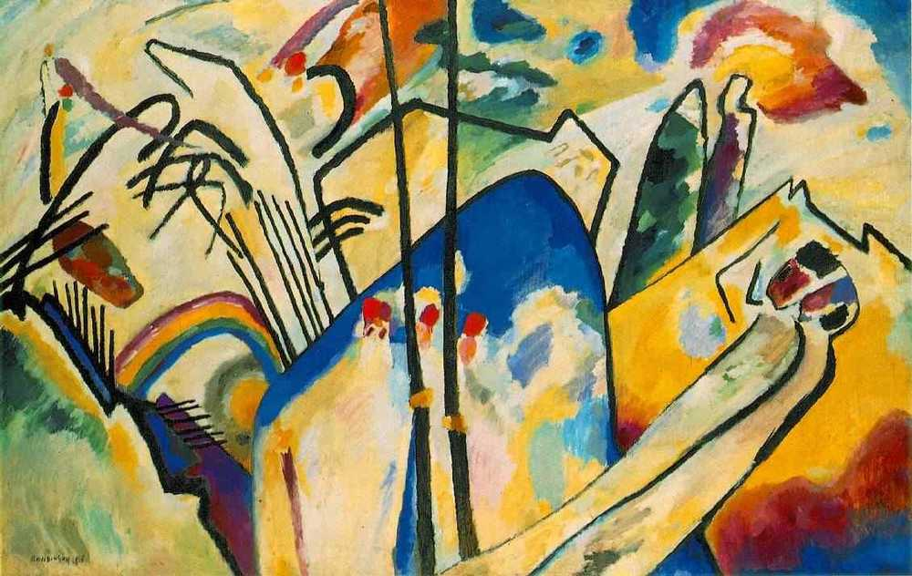
Wassily Kandinsky, 1911, Composition IV, o/c objective forms are “veiled” and “dissolved” "I more or less dissolved the objects so that they could not all be recognized at once, and so that their psychic sounds could be experienced one after the other by the observer."

Slide 22
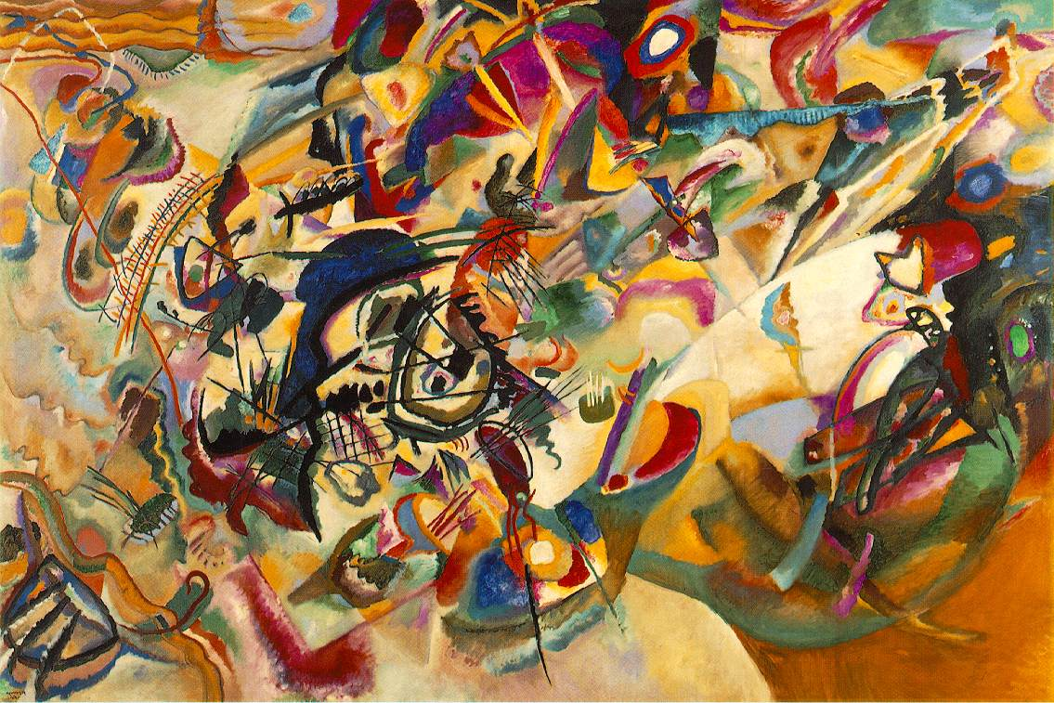
Wassily Kandinsky, Composition 7, 1913, o/c, 6’6” x 9’11”
"Generally speaking, color is a power which directly influences the soul. Color is the keyboard, the eyes are the hammers, the soul is the piano with many strings. The artist is the hand which plays, touching one key or another, to cause vibrations in the soul." Kandinsky

Slide 23
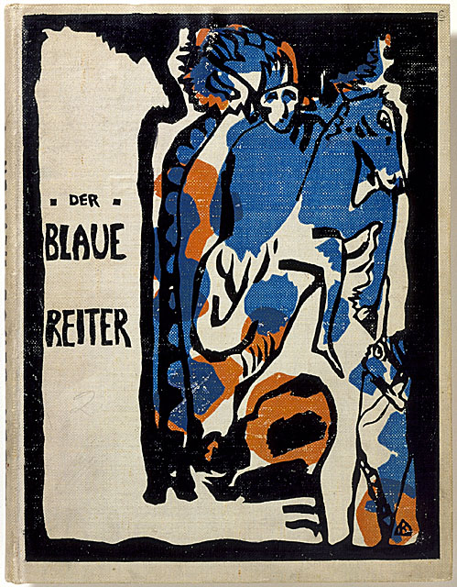
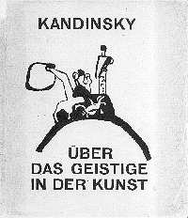
(left) Kandinsky, Cover of Der Blaue Reiter (The Blue Rider) Almanac, woodcut, 1912 (right) Kandinsky, Cover of Concerning the Spiritual in Art, 1912 "Then I saw heaven opened, and behold, a white horse! He who sat upon it is called Faithful and True and in righteousness he judges and makes war. He is clad in a white robe dipped in blood." Revelations

Slide 24
Hilma af Klint, Swedish, 1862- 1944, Paintings for the Future, Guggenheim Museum, New York City

Slide 25
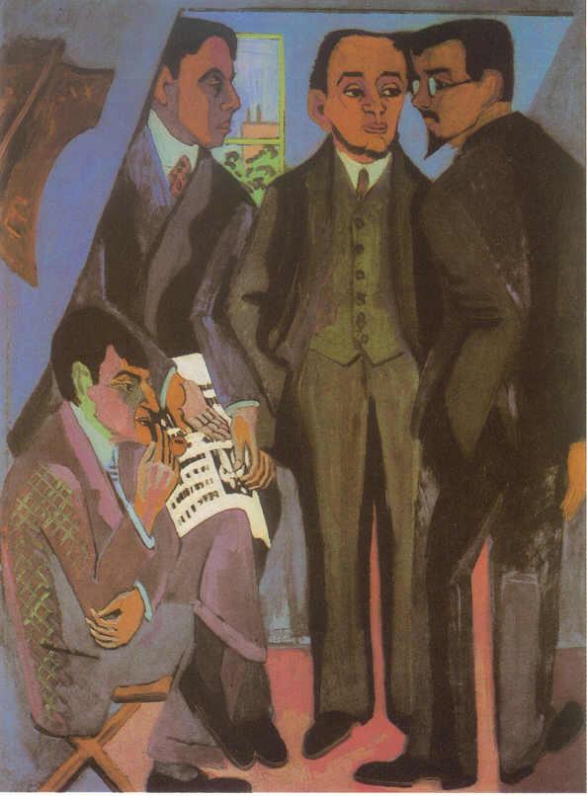
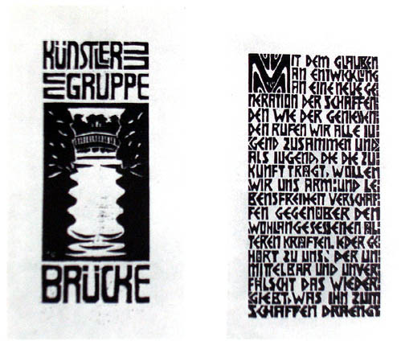
Die Brücke (The Bridge) Dresden Germany (left) Ernst Ludwig Kirchner (German, 1880-1938), The Painters of Die Brucke, 1925, o/c (L to R: Otto Muller, Kirchner, Erich Heckel, Karl Schmidt-Rottluff (right) Manifesto of the Artists’ Group the Brücke, woodcuts “With faith in progress and in a new generation of creators and spectators we call together all youth. As youth, we carry the future and want to create for ourselves freedom of life and of movement against the long established older forces. Everyone who reproduces that which drives him to creation with directness and authenticity belongs to us."

Slide 26
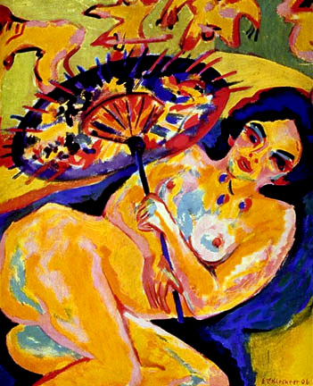
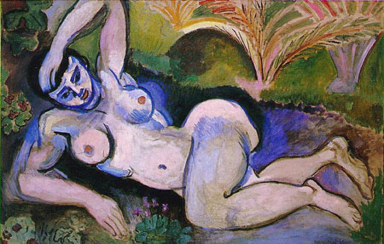
(left) Ernst Ludwig Kirchner, Girl With Japanese Parasol, oil, 1909 (Die Brücke) (right) Henri Matisse, Blue Nude: Souvenir of Biskra, 1907 (Fauve)

Slide 27
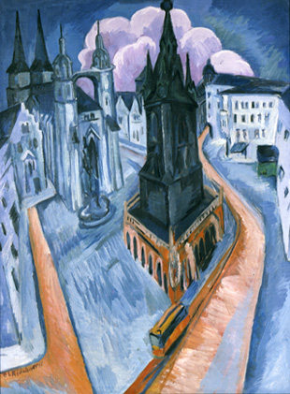
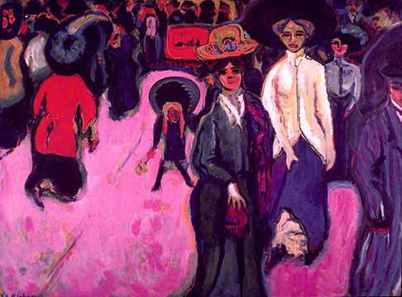
(left) Ernst Ludwig Kirchner, The Street, 1907, oil on canvas (right) Kirchner, Market Place with Red Tower, 1915, oil on canvas

Slide 28
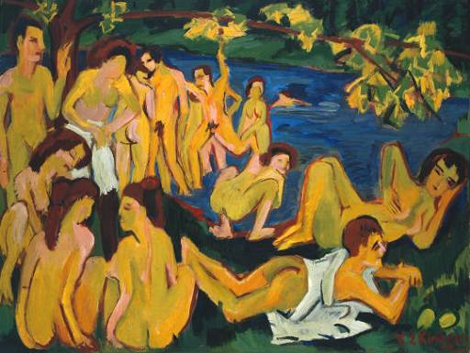
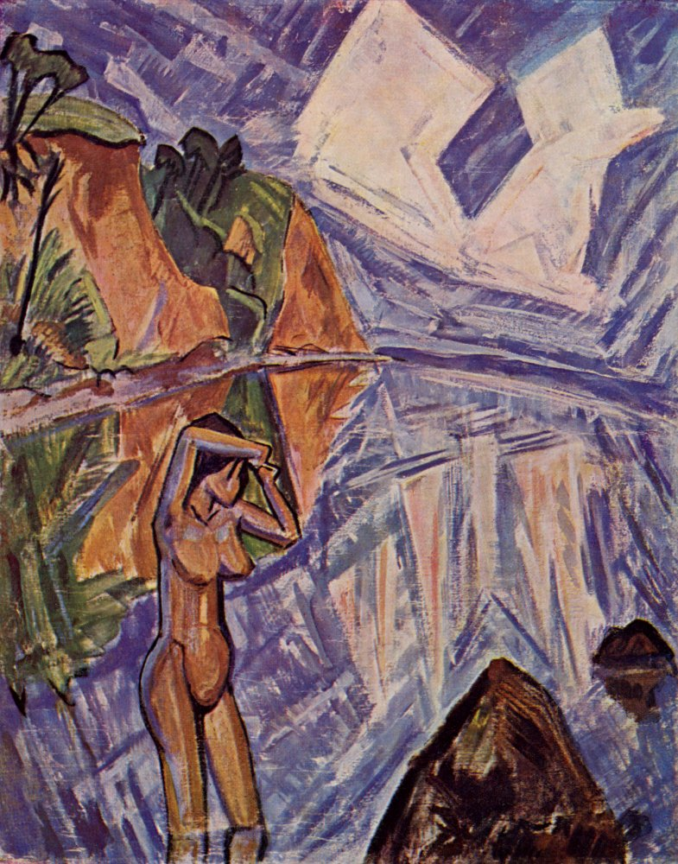
(left) Ernst Ludwig Kirchner, Nudes Playing Under the Trees, o/c 1910 (right) Erich Heckel (German, 1883-1970) Crystalline Day, o/c 1913 (Die Brücke) The subject of both is the Die Brücke Moritzburg retreat - rural bohemia (Edenic, Pre-Lapsarian, shared affinities with Germanic youth/nature cult)

Slide 29
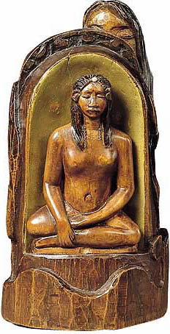
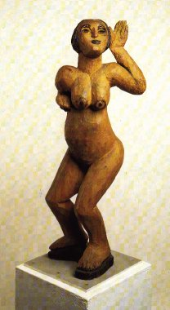
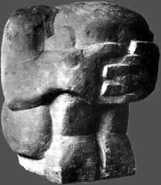
Ernst Ludwig Kirchner, Dancing Woman, 1911, wood polychromed (center) André Derain (French Fauve painter and sculptor, 1880-1954) Crouching Man, 1907, stone, 13 x 11” (right) Paul Gauguin, Idol, 1892, wood polychromed Expressionist Primitivism – French and German

Slide 30
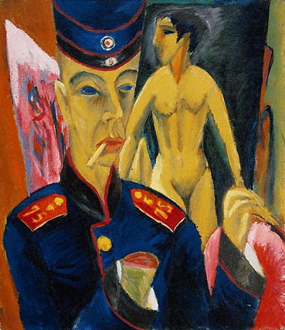
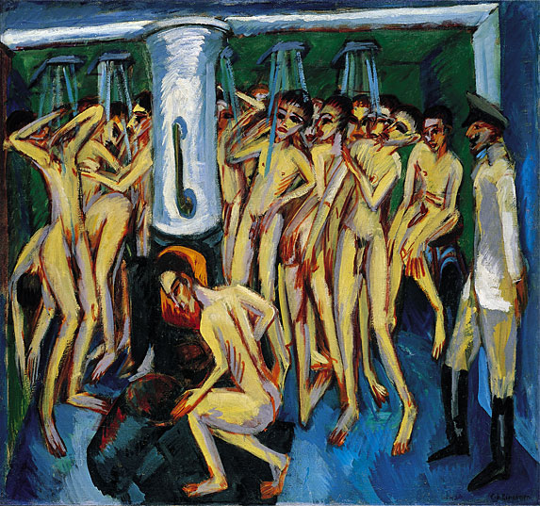
(left) Ernst Ludwig Kirchner, Self-Portrait as a Soldier, 1915 (right) Kirchner, The Soldier Bath (Artillerymen), 1915, oil on canvas, 55 x 59 inches

Slide 31
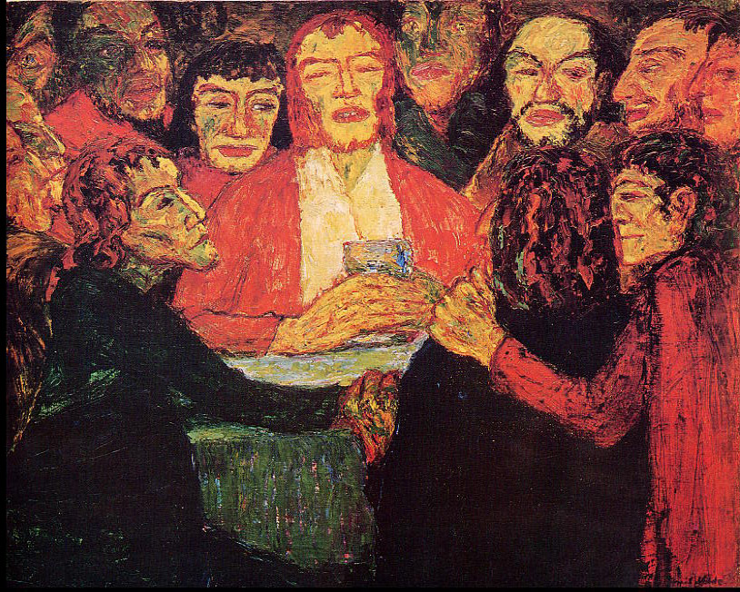
Emil Nolde (German, 1867-1956) , The Last Supper, 33 x 42” oil, 1909
No image of nature was near me, and now I was to paint the most mysterious, the profoundest, most inward event of all Christian religion! . . . I painted and painted, hardly knowing whether it was night or day, whether I was a human being or only a painter. Emil Nolde, Jahre der Kämpfe, 1902-14

Slide 32
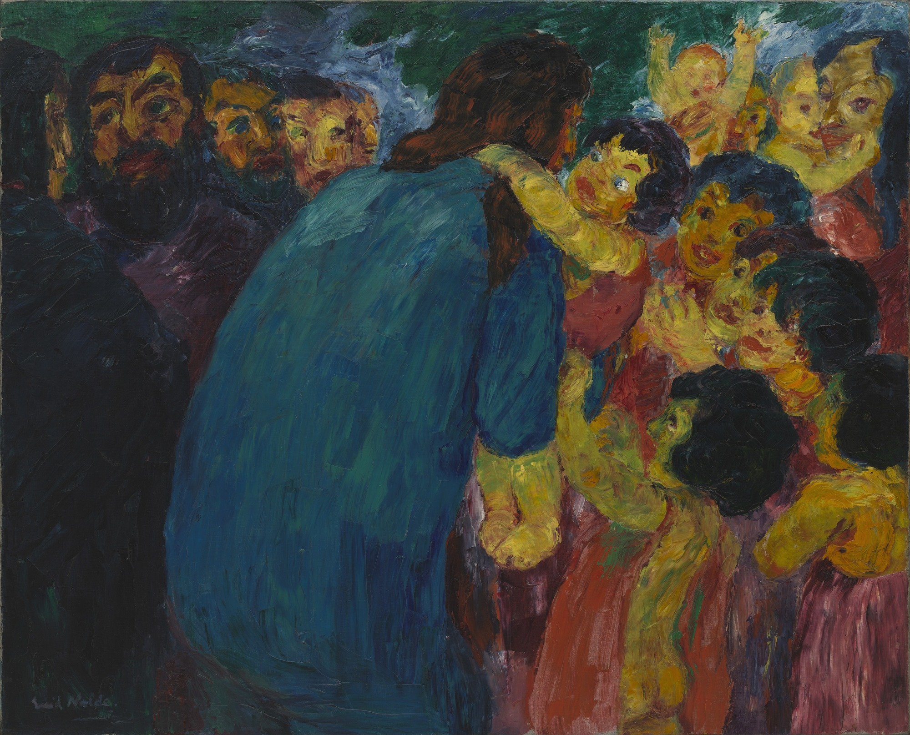
Emil Nolde, Christ and the Children, 1910

Slide 33
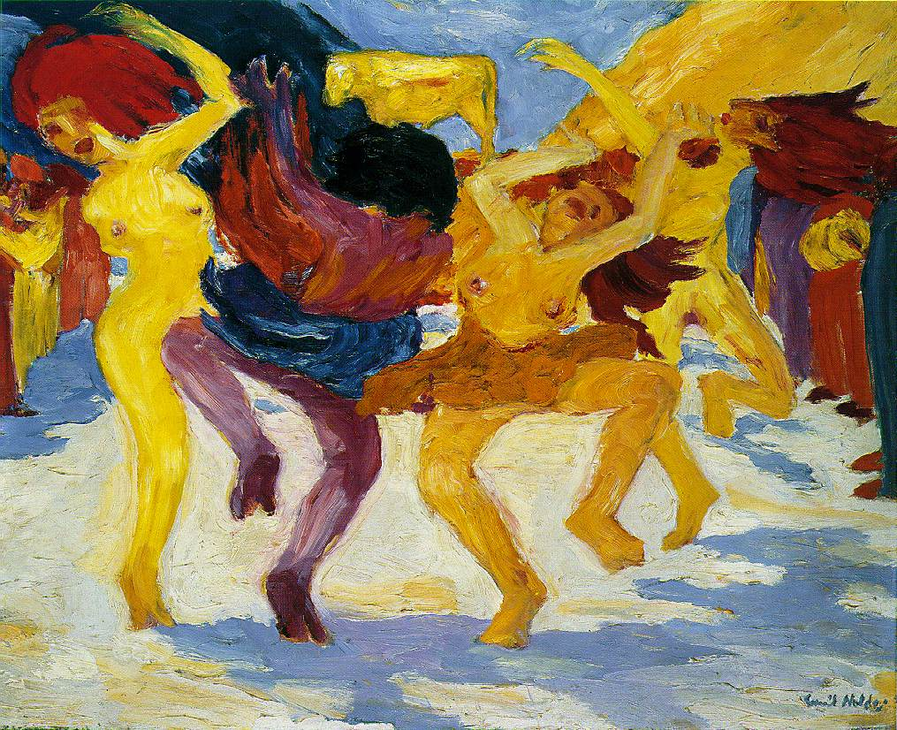
(left) Emil Nolde, Dance around the Golden Calf, 1910, oil on canvas, 88 x 105 cm, with detail, below. Visited German New Guinea in 1913. (right) Nolde, Prophet, 1912, woodcut.
Detail of Dance, showing gestural, impasto application of paint

Slide 34
Egon Schiele (Austrian 1890-1918), Self-Portraits, 1911

Slide 35
Egon Schiele (Austrian 1890 -1918), Danae, 1909, Oil and metal on canvas (right) Gustave Klimt (Austrian 1862 - 1918), Death and Life, 1908-9

Slide 36
Egon Schiele, Cardinal and Nun, 1912

Slide 37
Egon Schiele, The Self Seer II (Death and the Man), 1911, oil, 31 x 31”

Slide 38
Egon Schiele, Portrait of Paris von Gutersloh, 1918, oil on canvas, 55 x 43” Minneapolis Institute of Art

Slide 39
Oskar Kokoschka (Austrian 1886-1980) (left) Self-Portrait (Der Sturm, Berlin), 1910 Kokoschka (center and right), Murder, Hope of Women, 1909, poster and drawing for his play. First Expressionist play performed in Vienna, intended as blasphemy; OK called it a "gesture of defiance” meant to break down conventions of bourgeois society.

Slide 40
Oskar Kokoschka, Portrait of Adolf Loos, 1909, oil, 29 x 36”, Berlin

Slide 41
(left) Vincent Van Gogh, Père Tanguy, 1888 (center) Käthe Kollwitz, Lamentation: In Memory of Ernst Barlach (Grief), bronze, 1938 (right) Oskar Kokoschka, Adolf Loos, 1909

Slide 42
Compare the “expressionism” of Henri Matisse: “Expression. . . does not consist of the passion mirrored upon a human face or betrayed by a violent gesture.”
Notes of a Painter, 1908
Matisse, The Dance, 1909 (left); Kokoschka, Portrait of Adolf Loos, 1909 (right)

Slide 43
The life of the consciousness is boundless. It interpenetrates the world and is woven through all its imagery….One’s soul is a reverberation of the universe….It is love, delighting to lodge itself in the mind….Without intent I draw from the outside world the semblance of things; but in this way I myself become part of the world’s imaginings.
Oskar Kokoschka, “On the Nature of Visions,” 1912

Slide 44
Oskar Kokoschka, Bride of the Wind (The Tempest), oil, 5’11” x 7’3”, 1914, Basel, Switzerland Oskar Kokoschka and Alma Mahler

Slide 45
From Tom Lehrer’s ballad inspired by Alma Mahler’s obituary, New York City, 1967:
….
Her lovers were many and varied, From the day she began her -- beguine. There were three famous ones whom she married, And God knows how many between. Alma, tell us! All modern women are jealous. Which of your magical wands Got you Gustav [Mahler] and Walter [Gropius] and Franz [Werfel]?
….

Slide 46
(left) Max Beckmann (German 1884 – 1950), Self Portrait with Raised Hand, 1907 / among 85 self-portraits (center) Beckmann, Self Portrait as Medical Orderly, 1915 (right) Beckmann, Self Portrait with Red Scarf, 1917
1915
1907
1917

Slide 48
Europe during and after World War I: 1914 (left) and 1919 (right)

Slide 49
(left) Max Beckmann, Descent From the Cross, 1917 (right) Rogier Van Der Weyden (Netherlandish Northern Renaissance Painter, ca.1400-1464) Descent From the Cross, c. 1435

Slide 50
Max Beckmann, The Night, 1918-19, oil on canvas

Slide 51
Gothic cathedral relief showing the
damned: claustrophobic compression
shallow, frontal staging of Beckmann’s
Night and oeuvre.

Slide 52
Matthias Grünewald (German, c. 1480 - 1528) Isenheim Altarpiece (closed) , c. 1510-15 triptych, standard format for Christian altar paintings

Slide 53
Max Beckmann, Departure, 1932-33, oil on canvas, triptych center panel 7' 3/4" x 45 3/8“, MoMA NYC
Beckmann called the center panel "The Homecoming“: "The Queen carries
the greatest treasure – Freedom - as her child in her lap. Freedom is the one
thing that matters—it is the departure, the new start."

Slide 54
George Grosz (German 1893-1959) (left) Grey Day, 1921, oil on canvas (right) Grosz, Fit for Active Service (The Faith Healers), 1916-17, pen, brush, ink on paper, 20 x 14”, MoMA NYC. The artist is associated with New Objectivity and Berlin Dada movements but can be called a German Expressionist.

Slide 55
Otto Dix (German Expressionist, 1891-1969), Self Portraits as Soldier, 1914

Slide 56
Otto Dix, from print series, Der Krieg (War), etching with aquatint, 1924 (left) Mealtime in the Trenches, and (right) Skin Graft

Slide 57
Otto Dix, Triptychon der Krieg (War Triptych), oil, 1929-1932, Dresden

Slide 58
Otto Dix, The Skat Players – Card Pyaying War Invalids, 1920, oil and collage on canvas, 43x34”, Staatliche Museen zu Berlin

Slide 59
August Sander (German, New Objectivity, 1876-1964), Brick Carrier (left), and Cook (right) 1928, from the Face of Time portfolio. Sander was enormously influential on 20th century photographers

Slide 60
August Sander, Circus People from the portfolio, Citizens of the 20th Century, 1930

Slide 61
Albert Renger-Patzsch (German 1897 – 1966), New Objectivity Irons Used in Shoemaking, Fagus Works, c. 1925 (left) and Foxgloves, c. 1925 (right)

Slide 62
Hitler and Goebbels at the Degenerate Art (Entartete Kunst) exhibition exhibit, featuring over 650 paintings, sculptures, prints, and books from the collections of thirty two German museums, premiered in Munich on July 19, 1937 and remained on view until November 30 before travelling to eleven other cities in Germany and Austria.

Slide 64
“Good German Art” admired and supported by the National Socialist (Nazi) Party (left) Nazi artist, Ivo Saliger, Judgment of Paris, oil on canvas, Arno Becker, Predestination, 1938 (right)

Slide 65
Adolph Hitler (German 1889 – 1945), Landscape, 1925

